Slide 1

Big Data Project Proposal
Md Abdul Kader
Md Ahsan Kabir

Slide 2
Big Data Project Topic
Project Name
ProServ360: Proactive Service & Growth through Data Analytics

Slide 3
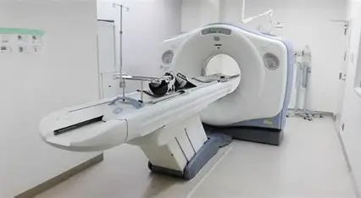
Problem Statement
Healthcare equipment in Bangladesh faces frequent breakdowns, leading to long downtime and increased repair costs.
Currently, there is no predictive mechanism to analyze large-scale service data. Hospitals and diagnostic centers lose significant revenue due to unexpected failures. Using Big Data analytics, the project aims to predict equipment downtime and reduce Mean Time to Repair (MTTR).
Notes:
Equipment Failure Analysis – used historical logs to find root causes and trends of breakdowns.

Slide 4

Project Objective
Project Overview
Enhance Equipment Performance
Leverage big data analytics to improve healthcare equipment reliability and reduce downtime.
Proactive Failure Prediction
Predict equipment failures early through analysis of usage and service data for timely maintenance.
Improve Customer Satisfaction
Deliver timely and effective maintenance to enhance service efficiency and customer satisfaction.
Optimize Resource Utilization
Transform reactive maintenance into strategic operations to achieve better patient outcomes.
Notes:
The primary objective of this project is to leverage big data analytics to enhance the performance and reliability of healthcare equipment. By analyzing customer service interactions and equipment usage data, the initiative aims to significantly reduce machine downtime and predict failures before they occur. This proactive approach will improve service efficiency and enable targeted upselling and cross-selling opportunities. Additionally, the project seeks to elevate customer satisfaction scores by delivering timely and effective maintenance solutions. The integration of predictive analytics into service operations will transform reactive maintenance into a strategic, data-driven process, ultimately leading to better patient outcomes and optimized resource utilization.

Slide 5
Previous Works
1. Predictive Maintenance in Healthcare Equipment – Studies show machine learning can reduce downtime by 20-30%.
2. Big Data in Hospital Operations – Research highlights improved decision-making and resource optimization using patient and service data.
3. IoT-enabled Monitoring – Prior works demonstrate real-time data collection from machines to detect anomalies early
4. Case Studies in Bangladesh & India – Limited but growing evidence of applying analytics to diagnostic centers and hospitals.
Notes:
1. Predictive Maintenance in Healthcare Equipment
Source: A Deloitte‑based report highlights AI‑driven predictive maintenance can reduce equipment downtime by 5–15%, boost labor productivity by 5–20%, and reduce inventory by 10–30%
Additional insights: Simbo.ai’s overview notes that organizations achieving predictive maintenance report 20–40% longer equipment lifespans, ~25% lower maintenance costs, up to 70% fewer breakdowns, and 30–50% reduced unplanned downtime
2. Big Data in Hospital Operations
Source: A paper exploring big data analytics (BDA) for hospital resource optimization and workflow management shows how real-time decision support via EHRs, patient flow, staffing, and equipment usage leads to improved resource allocation and operational efficiency
Complementary research: Another study demonstrates how BDA enables better risk management, thus enhancing healthcare quality outcomes
ScienceDirect
.
3. IoT-enabled Monitoring & Anomaly Detection
Source: A systematic review of IoT applications in healthcare delves into how sensors and communication technologies are being adopted for real-time monitoring
PMC
+6
ScienceDirect
+6
MDPI
+6
.
Supporting example: A proposed Anomaly Detection System (ADS) in smart hospital IoT setups integrates health/environmental monitoring with network intrusion detection to enhance system reliability
PMC
.
Broader context: IoT + Big Data research highlights how real-time monitoring and anomaly detection facilitate early diagnosis and personalized care
ResearchGate
.
4. Equipment Failure Analysis
Source: While a direct study on failure analysis in Bangladesh is limited, a cross-sectional study on radiology and imaging equipment utilization in district hospitals in Bangladesh reveals underlying issues like low utilization due to workforce and infrastructure gaps
ResearchGate
.
Supplementary insight: A systematic review on fault diagnostics in medical device manufacturing underscores the technical complexity and lack of standardized troubleshooting documentation
ResearchGate
+1
.
5. Case Studies in Bangladesh & India
Bangladesh-specific insight: The study on radiology equipment in district hospitals (Bangladesh) highlights functional status, workload, and underutilization issues in public hospitals
ResearchGate
.
Broader analytics in Bangladesh healthcare: A study identifying Big Data Analytics Capabilities (BDAC) in Bangladesh’s healthcare sector assesses domain-specific needs via expert consultation
MDPI
+2
Nature
+2
.
Summary Table
Research Topic Key Findings & Stats
Predictive Maintenance in Healthcare 5–15% downtime reduction; 20–40% longer equipment lifespan; up to 70% fewer breakdowns
Big Data in Hospital Operations Resource optimization via EHRs and workflow analytics; improvements in care quality outcomes
IoT Monitoring & Anomaly Detection Real-time sensor data integration; smart systems detecting anomalies and network events
Equipment Failure Analysis Usage inefficiencies in Bangladesh; challenges in failure diagnostics documentation
Regional Case Studies (Bangladesh/India) Underutilization of medical equipment; capability studies on local healthcare analytics frameworks

Slide 6
Simbo.ai – AI-Driven Predictive Maintenance in Healthcare Simbo.ai’s blog and research highlight:
70% fewer equipment breakdowns
30–50% reduction in unplanned downtime
20–40% longer equipment lifespan
25% lower maintenance costs
Their AI models use real-time sensor data and historical maintenance logs to predict failures with over 85% accuracy, enabling condition-based maintenance 2.
🔗 Explore Simbo.ai’s insights-Exploring Predictive Maintenance in Healthcare: How AI Can Revolutionize Equipment Management and Reliability | Simbo AI - Blogs

Slide 7

Deloitte – Predictive Maintenance in Healthcare and Industry
Deloitte’s comprehensive report outlines how predictive maintenance (PdM) powered by AI and IoT can:
Reduce equipment downtime by 5–15%
Boost labor productivity by 5–20%
Cut inventory costs by 10–30%
It emphasizes the use of smart sensors, edge computing, and machine learning to shift from reactive to proactive maintenance strategies. The report also includes a roadmap for implementing PdM across fixed and mobile assets 1.
🔗 Read the full Deloitte report-Predictive Maintenance Solutions | Deloitte US

Slide 8

GE Healthcare – OnWatch Predict for MRI
GE Healthcare’s OnWatch Predict system uses digital twins and AI to:
Increase MRI uptime by 4.5 days/year
Reduce unplanned downtime by up to 40%
Cut customer-initiated service requests by 35%
This solution is already deployed in over 1,500 MRI installations and is expanding to other imaging modalities 4.
🔗 Read GE Healthcare’s article-Title: Beyond Downtime: Redefining Predictive | GE HealthCare (United States)

Slide 9
LLumin – CMMS+ Predictive Maintenance Case Studies
LLumin’s CMMS+ platform is used across various industries, including healthcare, to:
Automate maintenance scheduling
Trigger alerts based on sensor thresholds
Improve compliance and reduce downtime
Case studies include applications in food safety, education, and energy sectors, with measurable improvements in uptime and maintenance efficiency3.
🔗 View LLumin’s case studies-LLumin’s CMMS+ Predictive Maintenance Case Studies

Slide 10

Gap Analysis
1. Most studies focus on developed countries, limited research in Bangladesh context.
2. Existing works emphasize patient data but less on equipment service and downtime data.
3. Lack of large-scale datasets (5GB+ real-world hospital machine logs).
4. Few predictive models customized for local hospital infrastructure and resource constraints.
5. Minimal integration of cost analysis and financial impact of equipment downtime.

Slide 11

Big Data Analytics Use Cases
Analytics Applications
Predictive Maintenance
Uses error logs and sensor data to forecast equipment failures and schedule proactive service visits.
Downtime Root Cause Analysis
Analyzes service tickets and engineer notes to identify recurring issues and improve training or parts quality.
Customer Contract Prediction
Examines contract renewals and complaints to initiate retention actions and reduce customer loss.
Parts Stock Optimization
Uses usage frequency and geographic data to ensure proper parts availability and reduce delays.
Notes:
Several key use cases have been identified for applying big data analytics in healthcare equipment maintenance. Predictive maintenance uses error logs, sensor data, and service history to forecast equipment failures and schedule proactive service visits. Downtime root cause analysis leverages service tickets and engineer notes to identify recurring issues and improve part quality or training. Customer churn prediction analyzes contract renewal patterns and complaint history to initiate retention actions. Service engineer performance metrics, such as response and fix times, help optimize field force allocation and identify training needs. Parts stock optimization uses usage frequency and geographic data to ensure the right parts are available at the right locations, reducing delays. Upselling opportunities are identified by analyzing usage data, modality gaps, and upgrade history, enabling targeted sales campaigns for equipment upgrades.

Slide 12
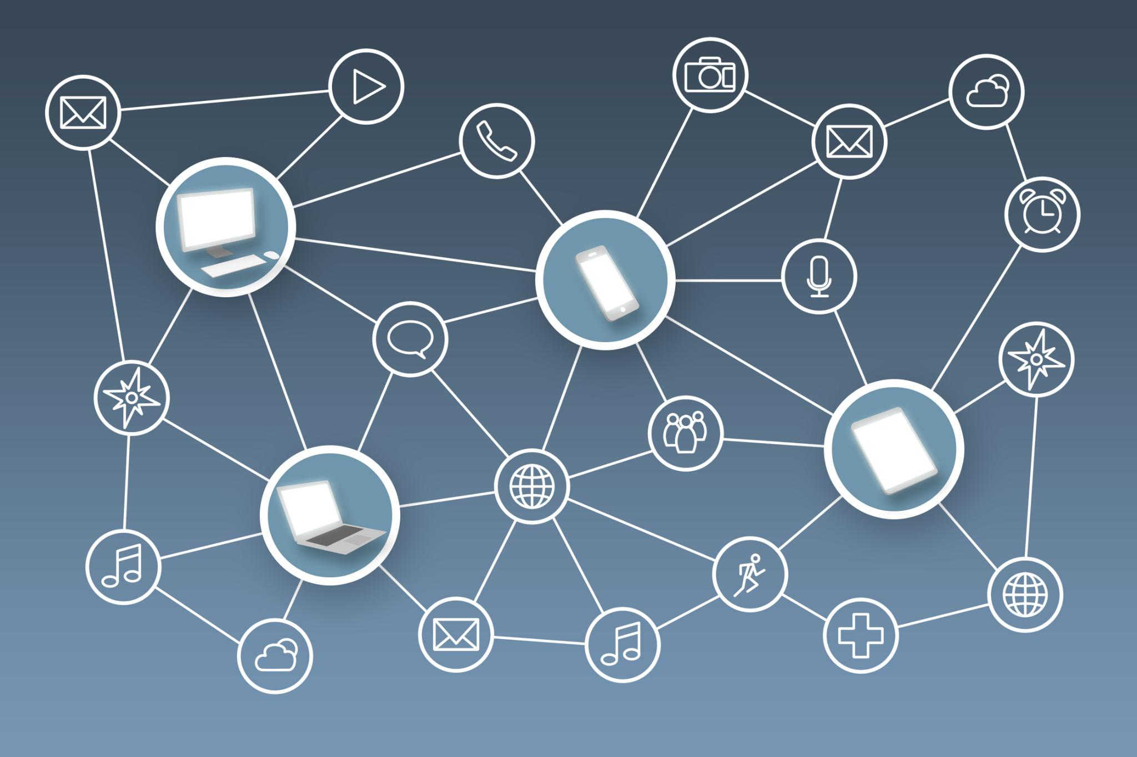
Data Sources
Data Infrastructure
Service History Data
Installation dates, service calls, and repair history reveal equipment lifecycle and maintenance trends.
Equipment Performance Data
Error logs and usage hours from CT, MRI, US, and PET-CT machines highlight operational efficiency.
Customer Interaction Data
CRM systems and call center logs provide insights into user experiences and service quality.
Supply Chain and Sales Data
Parts availability, backorder patterns, and contract details support inventory and retention strategies.
Notes:
The project utilizes a comprehensive array of data sources already available within GE systems. These include service history data such as installation dates, service calls, repair history, and parts replaced, which provide insights into equipment lifecycle and maintenance patterns. Equipment performance data, including error logs and usage hours from CT, MRI, US, and PET-CT machines, help assess operational efficiency and identify anomalies. Customer interaction data from CRM systems, complaint tickets, and call center logs offer a view into user experiences and service quality. Parts and supply chain data, including availability and backorder patterns, support inventory optimization. Sales and contract data, such as warranty details and renewal histories, inform customer retention strategies. External data like hospital size, patient volume, and public health statistics enrich the analysis by adding contextual relevance to equipment usage and service needs.

Slide 13

Implementation Steps
Execution Strategy
Data Consolidation
Phase 1 consolidates and cleans data from various systems like CRM, sales, and equipment logs for unified analysis.
Analytics Platform Setup
Phase 2 sets up visualization and machine learning tools such as Power BI and Python to generate predictive insights.
Actionable Insights Generation
Phase 3 creates real-time dashboards highlighting risks like downtime and parts shortage to inform decision-making.
Execution and Engagement
Phase 4 delivers alerts and reports to service teams and customers to enhance maintenance response and satisfaction.
Notes:
The implementation of the predictive maintenance project is structured into four phases. Phase 1 involves data consolidation, where data from service management systems like ServiceMax, CRM, sales, and equipment logs are pulled, cleaned, and merged. Phase 2 focuses on setting up the data analytics platform using tools such as Power BI, Tableau, or AWS QuickSight for visualization, and applying machine learning models using Python, R, or Azure ML for predictive insights. Phase 3 centers on generating actionable insights through real-time dashboards that display machine downtime risk scores, parts shortage alerts, and contract renewal risks. Customer health scorecards are developed by combining uptime, service satisfaction, and usage trends. Phase 4 is the execution phase, where predictive maintenance alerts are shared with service teams, targeted AMC/CMC renewal campaigns are launched, and automated health reports are sent to customers to enhance engagement and satisfaction.

Slide 14

Expected Impact
Business Outcomes
Reduced Unplanned Downtime
Predictive maintenance decreases unplanned downtime by 20-30%, improving equipment availability and patient care continuity.
Improved AMC/CMC Renewals
Proactive service and targeted campaigns enhance AMC/CMC renewals by 15-20%, boosting service engagement.
Optimized Inventory Costs
Optimized stocking strategies reduce inventory costs for parts by 10-15%, increasing operational efficiency.
Increased Customer Satisfaction
Timely maintenance leads to higher customer satisfaction and improved Net Promoter Scores (NPS).
Notes:
The anticipated impact of implementing predictive maintenance in healthcare equipment is substantial. Unplanned downtime is expected to decrease by 20–30%, leading to improved equipment availability and reduced disruptions in patient care. AMC/CMC renewals are projected to improve by 15–20%, driven by proactive service and targeted campaigns. Inventory costs for parts are estimated to drop by 10–15% through optimized stocking strategies. Additionally, customer satisfaction is expected to rise, reflected in higher Net Promoter Scores (NPS), as a result of timely maintenance and enhanced service experiences. These outcomes not only contribute to operational efficiency but also strengthen customer relationships and support long-term business growth.

Slide 15
Data Source
Service Max
Power BI
TTR- Total Time to Repair
ETTR- Elapse Time to Repair

Slide 16
Proposed Work
Planned Approach:
Collect minimum 5GB+ equipment downtime and repair service logs from hospitals.
Clean, preprocess, and structure the large dataset.
Apply Big Data tools (Hadoop/Spark) and machine learning models.
Methods:
Predictive modeling to forecast equipment downtime.
Anomaly detection for identifying early warning signs of breakdowns.
Repair time and cost analysis using historical trends.
Expected Outcomes:
Reduce downtime and Mean Time to Repair (MTTR).
Optimize resource allocation for service teams.
Financial savings for hospitals and improved patient care continuity.

Slide 17
Tools & Requirements
Tools & Computational Resources:
Google Colab Pro Subscription (for extended runtime, GPU/TPU access).
Python libraries: Pandas, NumPy, Scikit-learn, PySpark.
Big Data frameworks: Hadoop, Spark for handling 5GB+ dataset.
Visualization: Matplotlib, Tableau/PowerBI.
Requirements:
Reliable storage for hospital service logs (min 5GB).
Collaboration environment for team-based analytics.
Sufficient computational resources for training predictive models.

Slide 18

Thanks
Do you have any question ?

